Slide 1
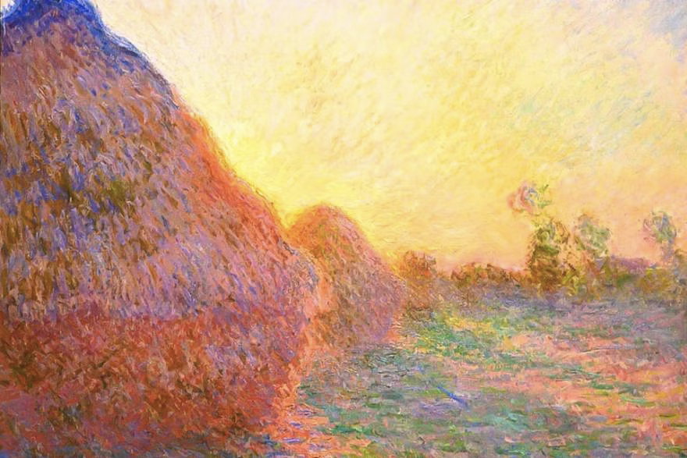
GANS Vs CNNs Comparative Analysis of Image Style Transfer Algorithms
Subtitle: Master's Project in Computer Vision
Names:
Christopher T Loo
Milica Pajkic
HSLU
Date: 12/10/2023

Slide 2
Agenda
Style Transformation
Introduction
Research Question
Overview Literature and Methodology
Models used
Lessons learnt and further improvements
Object Detection
Research Question
Dataset
Model
Results

Slide 3
Introduction
Definition of Image Style Transfer: Applying stylistic features of one image to the content of another.
Importance in real-world applications: Used in digital art, video games, and medical imaging. Right now: Tiktok Trend Highschool Yearbook Photos.
Technical challenges: Preserving content while altering style.
Scope of this study: Comparative analysis of 4 prominent algorithms, namely, CycleGANS, ResNet-50, InceptionV3 and VGG-19.

Slide 4
Research Question
How can we comprehensively assess and compare the effectiveness of CycleGANs, ResNet-50, InceptionV3, and VGG-19 in image style transfer, considering both image quality and processing speed, and subsequently, which optimization parameters and deep learning architecture emerge as the most suitable for achieving superior results in this domain?
1

Slide 5
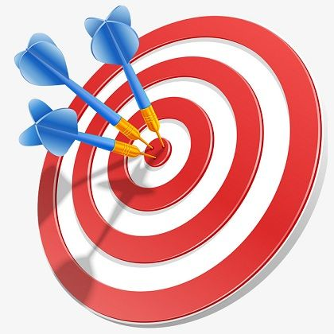
Research Objectives
1
Evaluate effectiveness of the 4 selected algorithms: Measure image quality and speed of obtaining generated images.
Compare based on performance metrics: Using perceived visual quality, and computational time.
Identifying optimization parameters and discovering best DL architecture for image style transfer: discovery of best architecture for image style transfer
2
3
Notes:
How does each of the four selected algorithms (CycleGANs, ResNet-50, InceptionV3, and VGG-19) perform in terms of image quality and speed when generating stylized images?
What is the comparative analysis of these algorithms regarding perceived visual quality and computational time when applied to image style transfer?
Which optimization parameters are most influential in enhancing the performance of image style transfer algorithms?
Based on the analysis, what is the best deep learning architecture for achieving optimal results in image style transfer?
ONE RQ: How can we comprehensively assess and compare the effectiveness of CycleGANs, ResNet-50, InceptionV3, and VGG-19 in image style transfer, considering both image quality and processing speed, and subsequently, which optimization parameters and deep learning architecture emerge as the most suitable for achieving superior results in this domain?

Slide 6
Short Literature Review
Early methods to CNNs: Moved from filters to neural networks.
Seminal papers: Gatys et al.¹ set the stage in 2015.
Existing benchmarks: Primarily focused on output quality, or quality of generated image.
Gaps in current research: Very few comparative analyses of GANS and/or CNNs in terms of image style transfer.

Slide 7
Methodology Overview
General Approach:
Standardized dataset – Monet paintings from Kaggle and a larger dataset from paintings of Candido
Standardized computing environment- Paid Google Colab+ environment to run codes. Code was ensured to run and be used in Google Colab without any errors.
Evaluation Metrics:
Perceived Image Quality
Computational time taken to generate new image

Slide 8
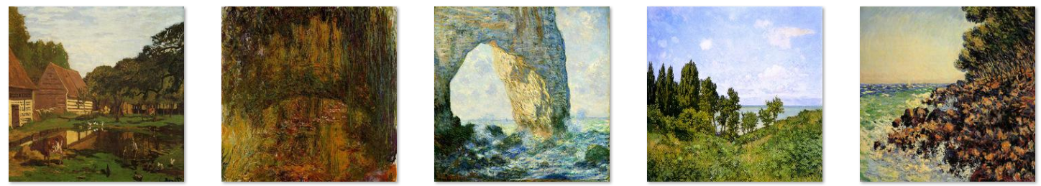
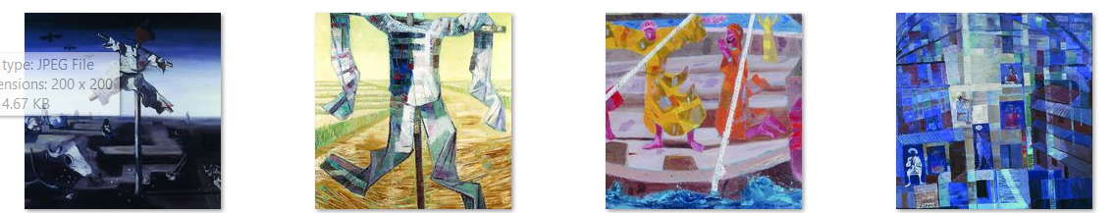
Datasets Used
Description:
Kaggle Monet Dataset:
monet_jpg - 300 Monet paintings in JPEG format
photo_jpg - 7028 photos in JPEG format
Candido-Portinari Dataset
Gandido - 4580 in JPEG format
Photo - 7947 in JPEG format
Preprocessing: All Images Resized to 256x256 and Normalized.

Slide 9
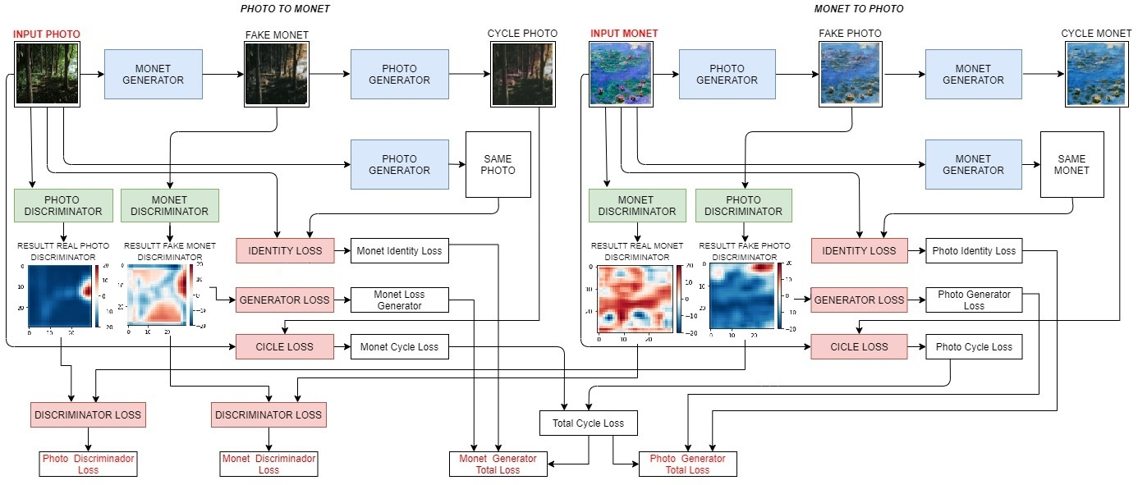
CycleGAN Justification
Architecture:
CycleGAN uses cycle-consistent adversarial networks 2 discriminators and 2 generators.
Cycle-consistency:
Cycle GAN is useful for unaligned datasets.
Justification for inclusion:
Good for high style fidelity.

Slide 10
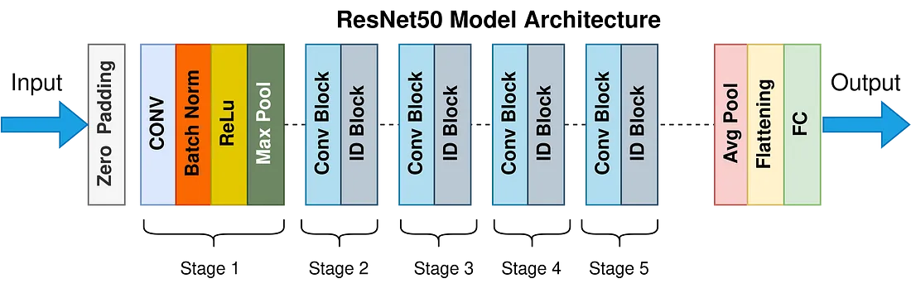
ResNet-50 Justification
Core concepts:
Deep residual networks, skip connections.
Previous applications:
Feature extraction.
Modifications for this project:
ResNet-50 transfer learning adapted for style transformation.

Slide 11
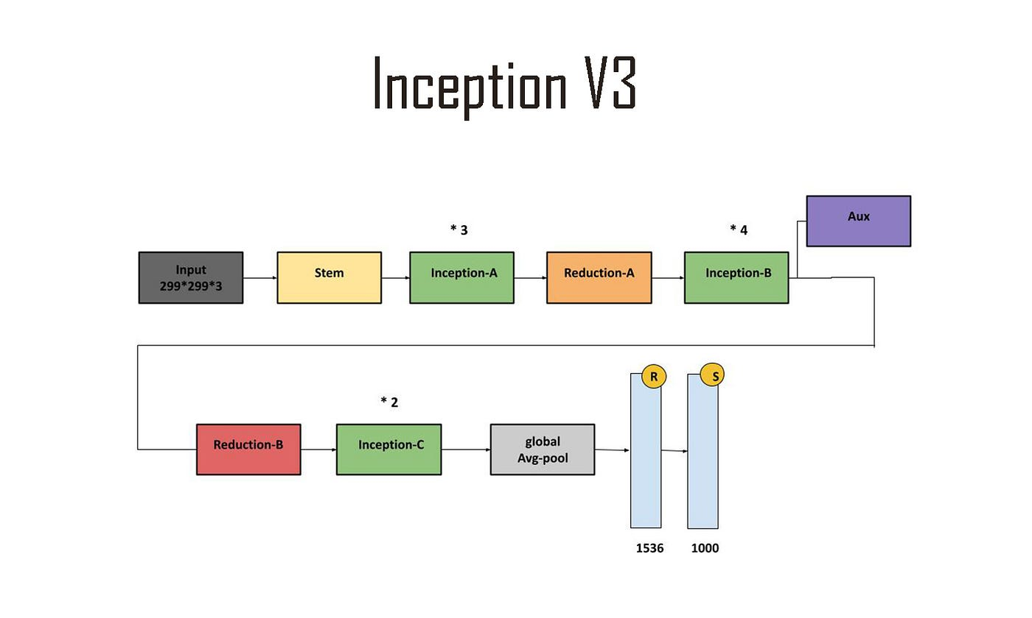
Inception V3 Justification
Inception modules:
Multi-level feature extraction.
Typical applications:
Object recognition.
Relevance to this research:
Low computational requirements.
Fast results.

Slide 12
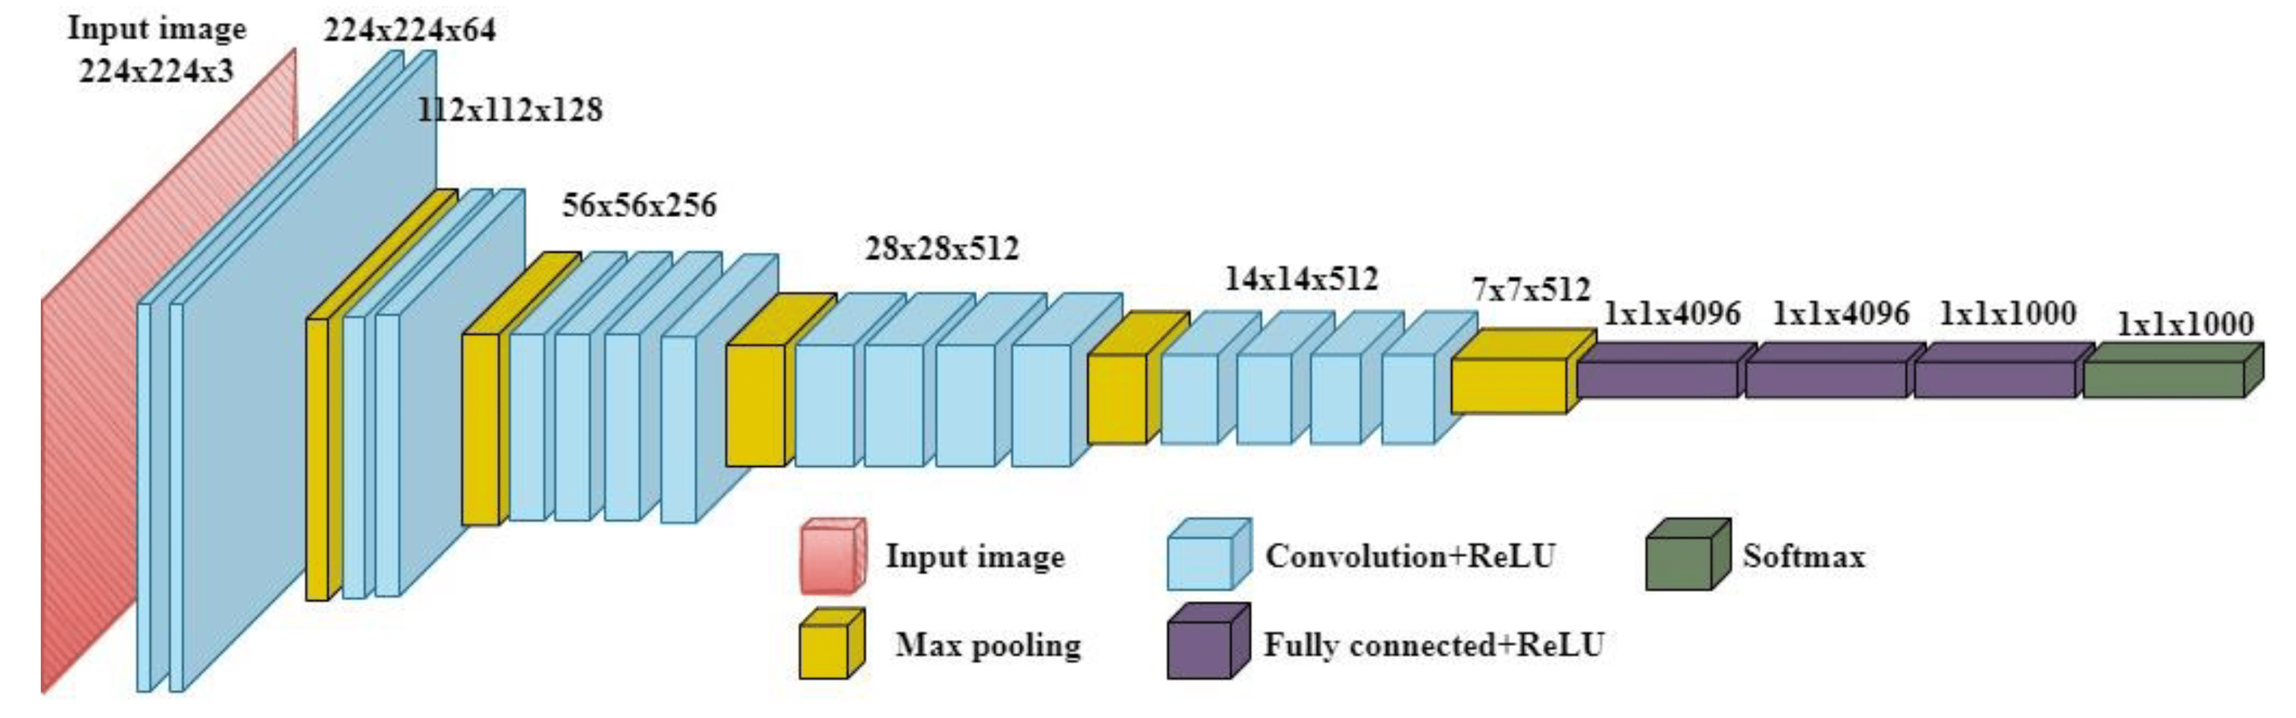
VGG-19 Justification
Architecture:
19-layer CNN.
Prior use-cases:
Image recognition
Customizations for this project:
Adapted for style transfer.

Slide 13
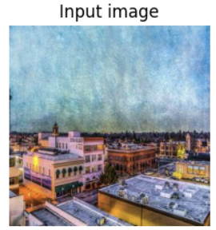
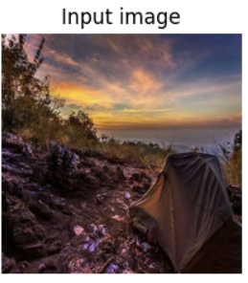
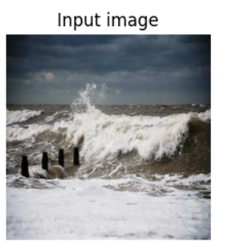
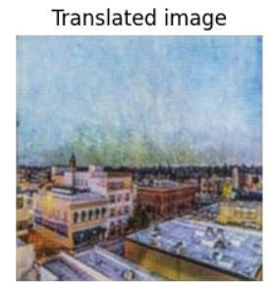
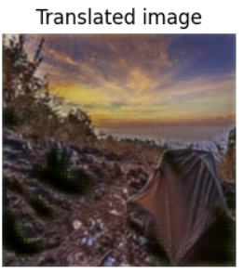
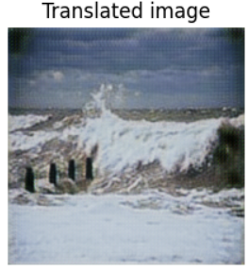
CycleGANS for Small Monet DataSet
Caution:
The limited size of the Monet paintings dataset could lead to potential overfitting issues with the CycleGAN model, causing it to possibly learn to replicate the input images instead of effectively generalizing to capture the intended art style.
Notes:
The limited size of the Monet paintings dataset could lead to potential overfitting issues with the CycleGAN model, causing it to possibly learn to replicate the input images instead of effectively generalizing to capture the intended art style.

Slide 14
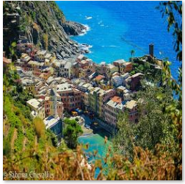
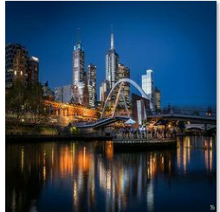
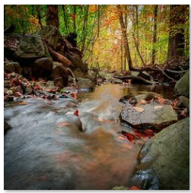
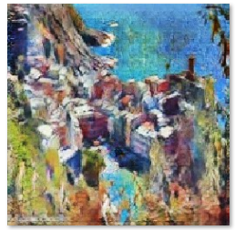
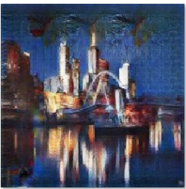
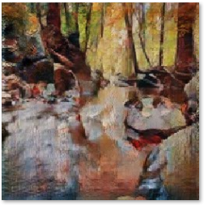
CycleGANS for the larger Candido DataSet
Input Images
A more extensive dataset, such as Candido, containing a wider variety of examples, contributes to a more resilient model. Consequently, CycleGAN has acquired the capability to perform a highly effective transformation.
Translated Images

Slide 15
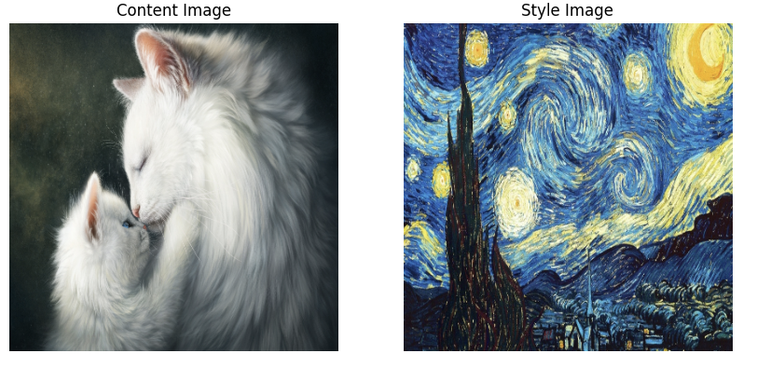


CNN transformation
?????
$$+$$
$$=$$

Slide 16
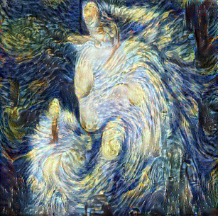
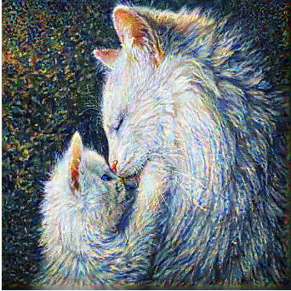
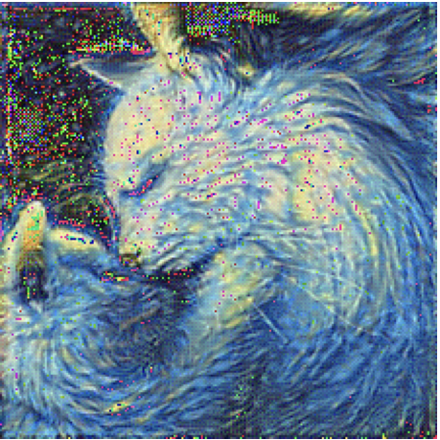
CNN Results
VGG-19
InceptionV3
ResNet-50

Slide 17
Lessons Learnt
Standout Performances: CycleGAN excelled in style transfer, while Inception V3 displayed impressive speed.
GANs' performance in style transfer benefits from larger and more diverse datasets.
Complexity doesn't guarantee superior results, as evidenced by the performance of ResNet-50.
Transfer learning using VGG-19 emerged as the most effective approach for image style transfer.
Trade-offs exist for each model, necessitating a balance between performance metrics and computational costs.
The importance of dataset selection, resizing, and normalization as crucial preprocessing steps.
Computer Vision is exceptionally time-consuming and financially demanding.
Study Limitations: Real-time processing is not feasible with the current approach.

Slide 18
Improving GAN performance - General
Visualize Often: Regularly inspect the output of your generator to ensure it is learning effectively.
Check Model Balance: If the generator or discriminator is consistently winning by a large margin, it suggests ineffective training. Adjust model complexity or learning rates accordingly.
Optimizers: Consider using the Adam optimizer, though for specific GAN types, RMSprop may be recommended in some papers.
Label Smoothing: Implement soft labels instead of hard 0s and 1s to prevent the discriminator from becoming overly confident during training.
Feature Matching: Instead of minimizing the distance between generated and real data, focus on minimizing the distance between features extracted from the data.

Slide 19
Improving GAN performance – further
For the Generator:
Tanh Activation: Use the tanh activation function for the generator's final layer to constrain output and aid discriminator learning.
Dropout Layers: Incorporate dropout layers to prevent the generator from overfitting to the training data.
Batch Normalization: Add batch normalization layers to stabilize training and improve the generator's generalization.
For the Discriminator:
Leaky ReLU: Utilize Leaky ReLU activation functions to allow a small gradient when the unit is inactive, enhancing discriminator learning.
Avoid Sparse Gradients: Prevent sparse gradients by using activation functions like Leaky ReLU and average pooling, as opposed to ReLU and MaxPool.

Slide 20
First try at a computer vision task: Object Detection with the widerface dataset
Notes:
Slide 5

Slide 21
Why Object Detection
In today's digital age, images and videos are omnipresent. Faces, being a central element in this visual data, play a crucial role in many applications. Detecting faces accurately is foundational for many subsequent tasks.
Challenges:
Faces in the wild come with variability: different orientations, lighting conditions, occlusions, and expressions. An effective detection system needs to navigate these challenges.
Advancements in Deep Learning:
The advent of deep learning has ushered in significant improvements in face detection accuracy. Harnessing these advanced architectures, like ResNet-50, can push the boundaries of what's possible.

Slide 22
Object Detection
In training on the WIDER FACE dataset, how do the performances of various object detection models compare, and to what extent can minor hyperparameter adjustments influence these outcomes?"
1

Slide 23
Unpacking the WIDER FACE Dataset
A leading face detection benchmark dataset, pivotal in driving advancements in the domain.
Boasts of rich annotations that classify images based on event category, difficulty level (easy, medium, hard), precise bounding box delineations, and more.
Challenges
Heterogeneity in image resolutions and quality can pose challenges for consistent face detection.
Presence of faces showcasing extreme poses, heavy occlusions, or under varied lighting conditions may impede detection accuracy.
Certain images bear inconsistent bounding box annotations, demanding meticulous preprocessing.
The inclusion of diminutive bounding boxes frequently culminates in subpar Intersection over Union (IoU) scores, affecting overall model performance.

Slide 24
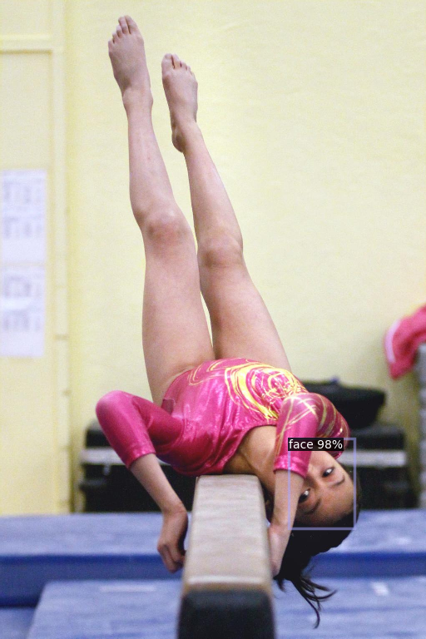
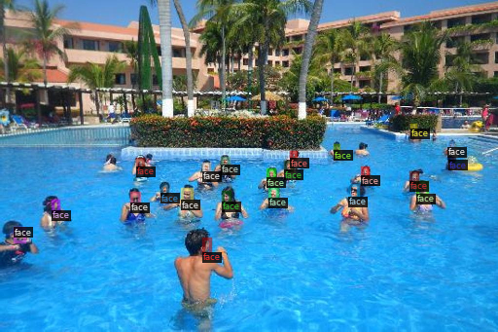
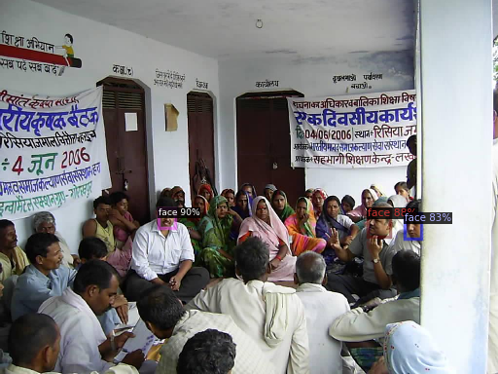
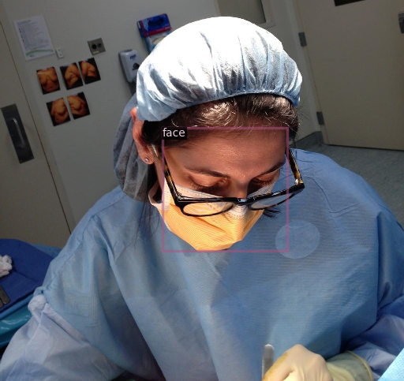
Annotation of Data
Annotation of Data

Slide 25
Introduction to Detectron2 with RetinaNet
Developed by Facebook's FAIR.
Detectron2: A robust framework for object detection tasks.
RetinaNet with ResNet-50 Backbone:
RetinaNet's Core: Harnesses the depth of ResNet-50, encapsulating 50 layers of deep learning.
Mastery of Residual Learning: Uses ResNet-50's innovative "Residual Blocks" to seamlessly tackle the vanishing gradient challenge.
Learning Approach: Focuses on understanding residuals over an untouched function, enabling the depth of the model without optimization hurdles.
Bottleneck Design: Integrates a compact yet efficient pattern, ensuring powerful performance without unnecessary bulk.

Slide 26
Subset of Dataset
Dataset limitations led to reconsideration.
Selection process: Aimed at enhancing detection reliability.
Chose images emphasizing frequent tasks and clarity.
Excluded images with minuscule bounding boxes to improve IoU.

Slide 27
Results Resnet:
Metric | Smaller Subset | Larger Subset
Images | 74 | 577
Annotations | 75 | 3026
Inference Time (per img) | ~0.047s | ~0.042s
AP (IoU=0.50:0.95) | 66.66% | 40.50%
AP (IoU=0.50) | 97.98% | 70.52%
AP (IoU=0.75) | 82.38% | 43.03%
AP (Small Faces) | N/A | 19.37%
AP (Medium Faces) | N/A | 59.21%
AP (Large Faces) | 66.66% | 62.05%
Recall (Top 100) | 71.3% | 46.5%

Slide 28
Results
Overall Performance: Both subsets achieved decent Average Precision (AP) scores, especially at IoU=0.50, suggesting that the model is capable of detecting faces accurately in both scenarios.
Comparison: As expected, the model performed better on the smaller subset than the larger one. This could be due to the reduced complexity and lesser variability in the smaller dataset.
Object Size Sensitivity: The model seems more adept at detecting medium and large faces than smaller ones, as observed in the AP scores for different object sizes in the larger subset. This suggests potential areas of improvement, especially in enhancing detection accuracy for smaller faces.
Recall: While the recall scores are not extremely high, they are still respectable. This suggests that while the model may miss some faces, the ones it does detect are accurately bounded.

Slide 30
Citations
References
[1] Justin Johnson, Alexandre Alahi, and Fei-Fei Li. Perceptual losses for real-time style transfer and super-resolution. CoRR, abs/1603.08155, 2016.
[2] Jun-Yan Zhu, Taesung Park, Phillip Isola, and Alexei A. Efros. Unpaired image-to-image translation using cycle-consistent adversarial networks, 2020
[3] Karen Simonyan and Andrew Zisserman. Very deep convolutional networks for large-scale image recognition. CoRR, abs/1409.1556, 2014.
[4] Leon A. Gatys, Alexander S. Ecker, and Matthias Bethge. A neural algorithm of artistic style. CoRR, abs/1508.06576, 2015.
[5] Michael Tschannen, Olivier Bachem, and Mario Lucic. Recent advances in autoencoder-based representation learning. arXiv preprint arXiv:1812.05069, 2018.
[6] Susant Achary. https://medium.com/analytics-vidhya/detectron2-by-facebook-ai-research-is-here-b666987ad8b8
[7] https://detectron2.readthedocs.io/en/v0.4.1/_modules/detectron2/modeling/backbone/resnet.html
[8] Hiroto Honda. https://medium.com/@hirotoschwert/digging-into-detectron-2-part-2-dd6e8b0526e

Slide 31
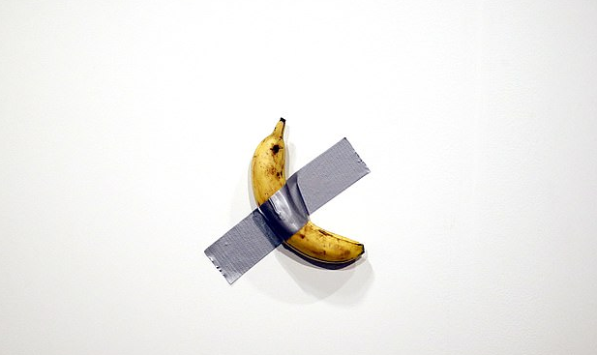
THE END

